Slide 1
Third Session – Topics for the training material
Challenge from water scarcity and droughts
Maria Manuela Portela
University of Lisbon / Instituto Superior Técnico (UL/IST), Department of Civil Engineering, Architecture and Georesources
Workshop on innovative practices in the EU water sector: barriers and opportunities / 8th to 10th May 2019
This project has been funded with support from the European Commission. This publication reflects the views only of the author, and the Commission cannot be held responsible for any use which may be made of the information contained therein.

Slide 2
Third Session – Topics for the training material
Challenge from water scarcity and droughts
Topics for the training material
Maria Manuela Portela
University of Lisbon / Instituto Superior Técnico (UL/IST), Department of Civil Engineering, Architecture and Georesources
Workshop on innovative practices in the EU water sector: barriers and opportunities / 8th to 10th May 2019
This project has been funded with support from the European Commission. This publication reflects the views only of the author, and the Commission cannot be held responsible for any use which may be made of the information contained therein.

Slide 3
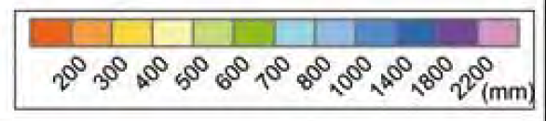
Pronounced hydrological variability
Spain
Atlantic Ocean
Portu-gal
Spain

Slide 4
Pronounced hydrological variability
Mean annual values of the rainfall, P, and surface runoff, H
Spain
Atlantic Ocean
P > 2 800 mm
H > 2000 mm
Portu-gal
Spain
P < 500 mm
H < 25 mm

Slide 5
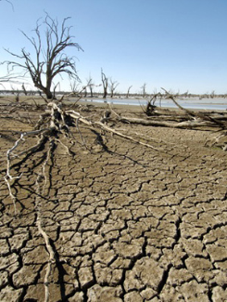
1. Introduction, study area, precipitation data, and drought index
Droughts are among the most complex and least understood natural hazards, affecting more people than any other one. They are also recurrent events specially in areas with pronounced natural hydrological temporal variability.
Droughts are generally associated with the persistence of low rainfall, soil moisture and water availability relative to the normal levels in a given area.
(common definition)… DROUGHT a sustained and regionally extensive occurrence of below average natural fresh water availability …
Different from other extreme hydrological events (floods), droughts remain a less visible natural risk, whose impacts are not systematically recorded.
5

Slide 6
Most common steps of a drought characterization study
(to be totally or partially addressed in a course on the issue)
Selection of the drought index
Definition of homogeneous regions regarding the spatial pattern of the drought index
Characterization of the droughts
Development of monitoring, forecasting and alert systems
Topics for the training material
(also the capabilities that IST can offer … for the time being, without agenda nor budget)
6

Slide 7
Most common steps of a drought characterization study
(to be totally or partially addressed in a course on the issue)
Selection of the drought index
Definition of homogeneous regions regarding the spatial pattern of the drought index
Characterization of the droughts
Development of monitoring, forecasting and alert systems
7

Slide 8
Most common steps of a drought characterization study
Selection of the drought index (selection strongly constrained by the available hydrological information) - Standardized Precipitation Index (SPI), Standardized Precipitation-Evapotranspiration Index (SPEI), Palmer Drought Severity Index, Drought Severity Index (DSI), Crop Moisture Index (CMI), Normalized Difference vegetation Index (NDVI), Deciles, Surface Water Suply Index (SWSI), US Drought Monitor (USDM), Vegetation Drought Response Index (VegDRI), …
The development of drought indices has been always affected by the lack of an adequate definition of the phenomenon due to its complex nature and difficulty in evaluating its different impacts
A wise approach before making a decision regarding the index to use should account for the acquisition of the required information and for the benefits and limitations of each index in order to decide which one is the most suitable for each particular application
8

Slide 9
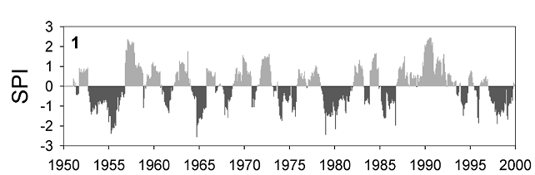
Selection of the drought index (cont.)
One of the most common index is the standardized precipitation index, SPI due to its:
(i) Few data requirements (only rainfall series)
(ii) great flexibility because it may be applied at different time scales;
(iii) lower complexity of calculation comparative to other indexes, as it is based on a well defined and relatively simple probabilistic model;
(iv) possible application to other hydro-climatological variables besides precipitation, such as streamflows; and
(v) suitability to the spatial representation and to the comparison of droughts in different “environments” because it is a normalized index.
9

Slide 10
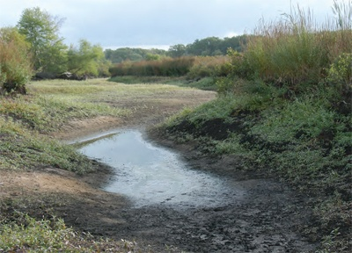
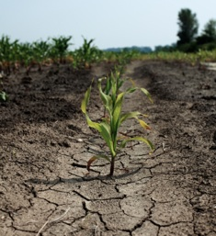
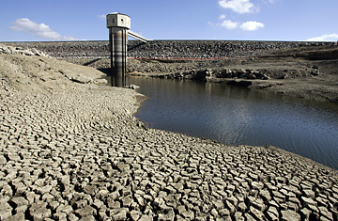
Selection of the drought index (cont.)
Basically, the SPI quantifies the precipitation deficit at different time scales (1, 3, 6, 12 and 24 months), which reflect the impact of droughts on the different types of reservoirs of fresh water at the watershed level.
It is generally agreed that up to 6 months the SPI addresses the meteorological and agricultural droughts (which are associated to precipitation and soil moisture deficits, respectively); between 9 and 12 months, the hydrological droughts (with water shortage reflected in the streamflows and in lakes and artificial reservoirs); and for 24 months the impact of the droughts on the aquifers (that have a slower response due to their resilience).
10

Slide 11
Selection of the drought index (cont.)
The SPI remaps the precipitation records into a standardized probability distribution function so that an index of zero indicates median precipitation amount, while a negative value stands for drought conditions and a positive one, for wet conditions.
Drought threshold
Drought events
11

Slide 12
Selection of the drought index (cont.)
1. Introduction, study area, precipitation data, and drought index
For a given time scale (1 to 24 months) the calculation of SPI requires the adjustment of a probability distribution function to the corresponding sample of cumulative precipitation.
The value of SPI assigned to each precipitation is the z-standard normal for the probability of non-exceedance of that precipitation, according to the probability distribution function adopted (Pearson type III distribution function with parameters estimated by the L-moments method).
Normal distribution
Postulated distribution
SPI
z-standard normal
P or Σ P
12

Slide 13
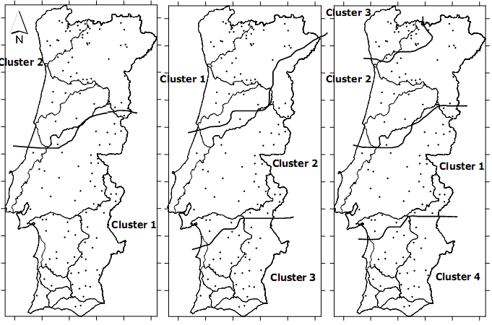
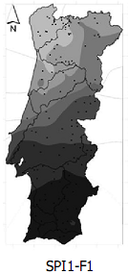
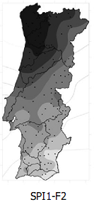
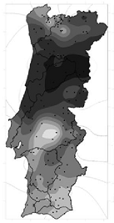
Most common steps of a drought characterization study
Selection of the drought index (selection strongly constrained by the available hydrological information)
Definition of homogeneous regions regarding the spatial pattern of the drought index (based on Principal Component Analysis, PCA, non-hierarchical cluster analysis, KMC, …)
13

Slide 14
Most common steps of a drought characterization study
Selection of the drought index (selection strongly constrained by the available hydrological information)
Definition of homogeneous regions regarding the spatial pattern of the drought index (based on Principal Component Analysis, PCA, non-hierarchical cluster analysis, KMC, …)
… mandatory and relevant issue due to the regional nature of the droughts
14

Slide 15
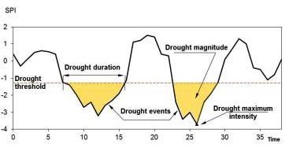
Most common steps of a drought characterization study
Selection of the drought index (selection strongly constrained by the available hydrological information)
Definition of homogeneous regions regarding the spatial pattern of the drought index
Characterization of the droughts, generally in terms of their spatial extent, severity (maximum value), duration of the periods under droughts
conditions, magnitude (cumu-lative intensity) and frequency (question to tackle: has the frequency of the drought events changed over time, regardless their severity, i.e., regardless the amount of the precipitation deficit?)
15

Slide 16
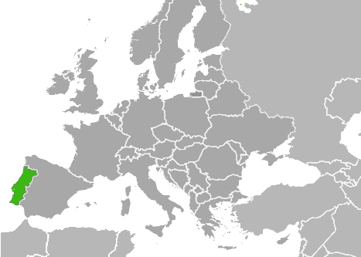
1. Introduction, study area, precipitation data, and drought index
The Portuguese team has a considerable experience in drought analysis (the team developed stepwise approaches that were extensively applied initially in Portugal and afterwards in several other countries through international collaborations – Mozambique, Angola, Southern Paraguay, Northern Argentina, El Salvador, Brazil, Slovakia, …)
Atlantic Ocean
Portugal
16

Slide 17
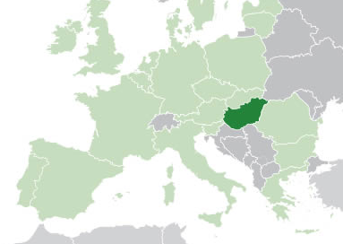
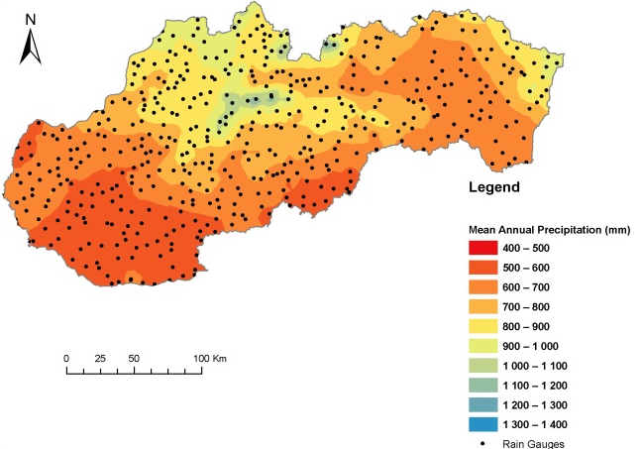
1. Introduction, study area, precipitation data, and drought index
Application of the models developed by IST to Slovakia – study based on monthly precipitations, from January 1981 to December 2013 (33 years), in the 491 rain gages evenly distributed over the country
Slovakia
Portugal
Spain
Schematic location of the 491 rain gages over a map of the mean annual precipitation
17

Slide 18
3. Drought temporal patterns
Slovakia
Homogeneous regions, on the left side, and
λ(t)
λ(t)
λ(t)
λ(t)
18

Slide 19
3. Drought temporal patterns
Slovakia
Homogeneous regions, on the left side, and frequency of the periods under droughts conditions, on the right side new non-parametric approach for smoothing point data process
Kernel occurrence rate estimation method (KORE) coupled with bootstrap confidence bands.
λ(t)
λ(t)
λ(t)
λ(t)
19

Slide 20
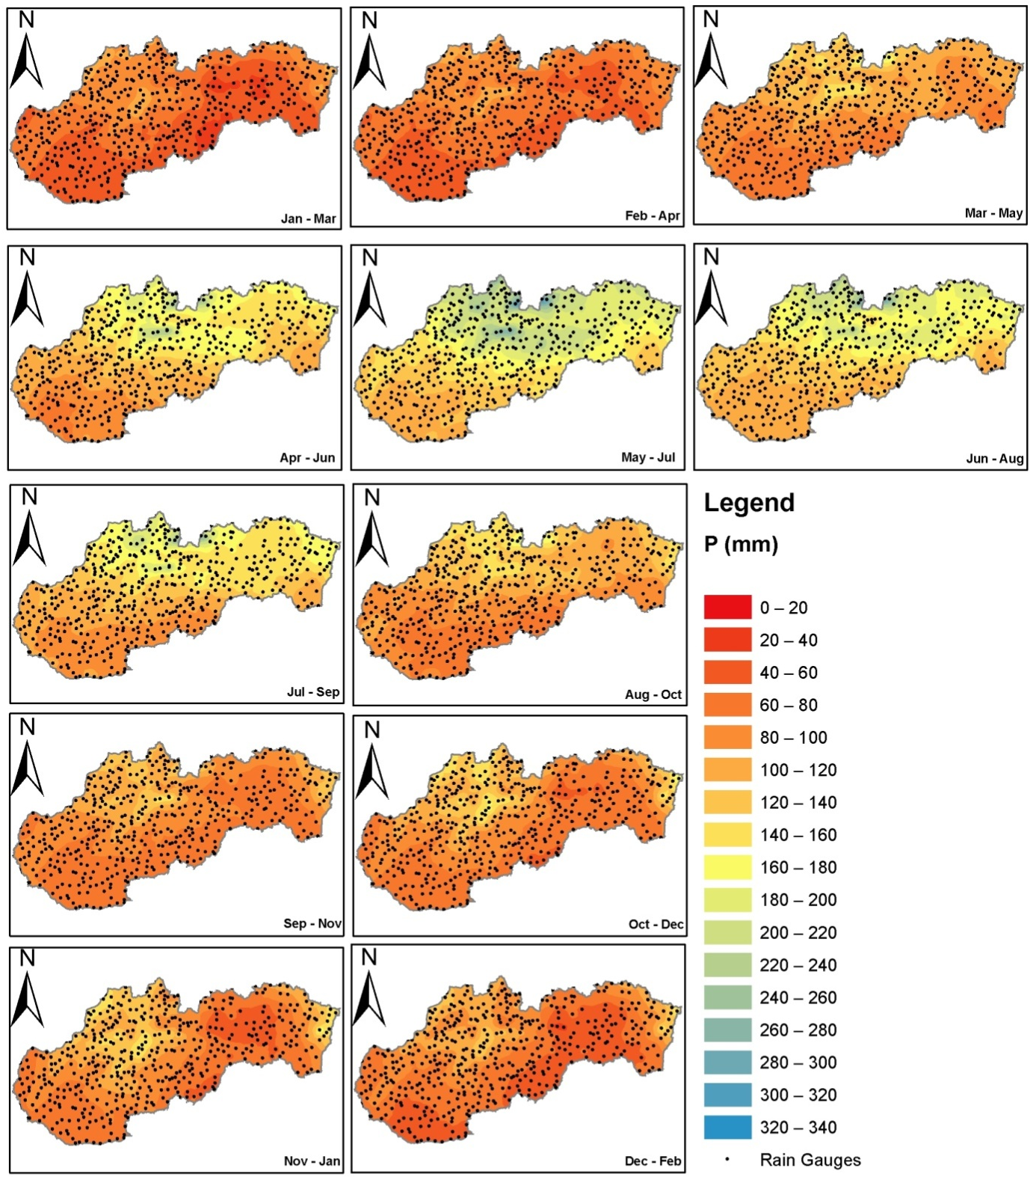

4. Precipitation surfaces for drought recognition
Jan-Mar
Feb-Apr
Mar-May
Apr-Jun
May-Jul
Jun-Aug
The team also developed a completely new concept aiming at the drought monitoring and early alert – rainfall surfaces for drought recognition (a simple comparison of the actual rainfall with the one given by the surface enables to issue a drought alarm)
Jul-Sep
Aug-Oct
Sep-Nov
Oct-Dec
20
Nov-Jan
Dec-Feb

Slide 21
For the time scale of 3 months, rainfall surfaces for drought recognition of severe droughts in mainland Portugal (SPI3 –a.28)
21

Slide 22
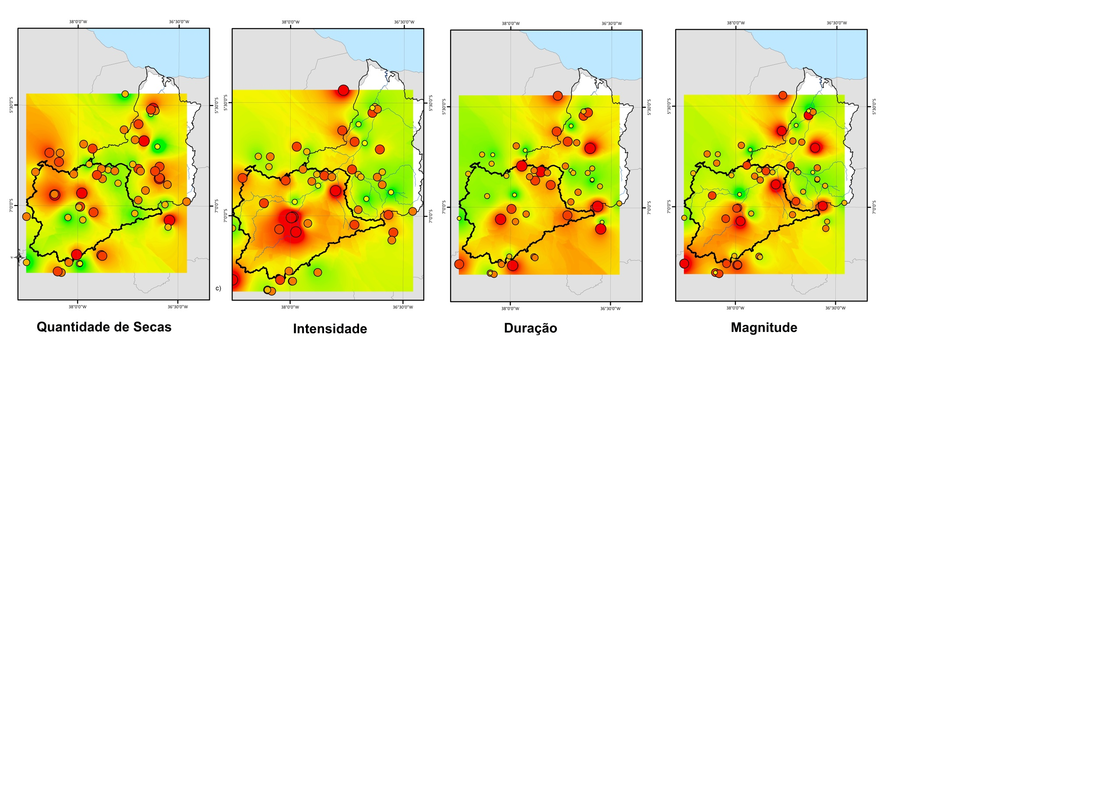
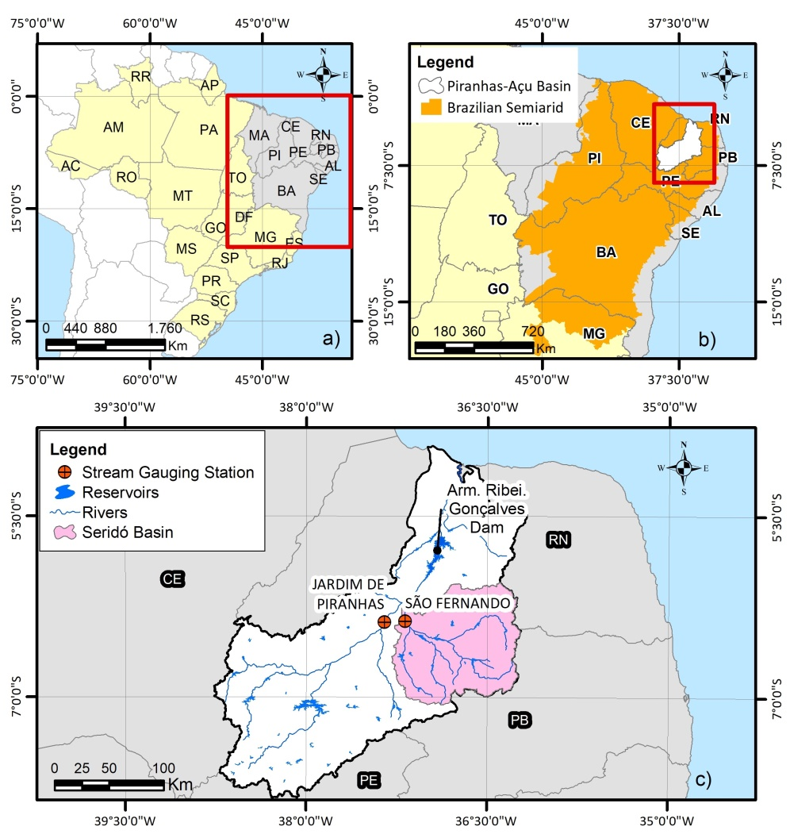
Characterization of the droughts in Brazilian semiarid (approx. 44000km²)
Number Intensity
Duration Magnitude

Slide 23
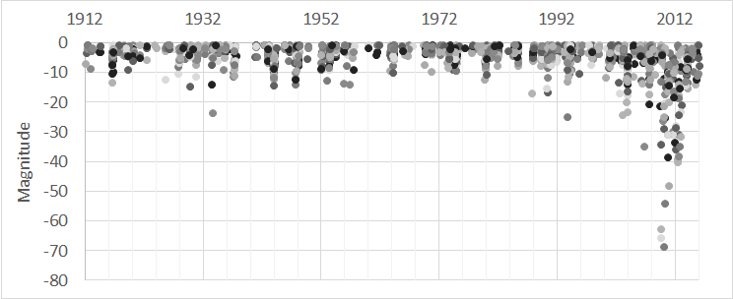
Droughts and water scarcity are major issues whose relevance tends to increase
Some results (from last April!) about the temporal evolution of the droughts over mainland Portugal from October 1910 until September 2018 (108 years)
Magnitude (cumulative severity)
Very pronounced increase towards of the magnitude in recent years
23

Slide 24
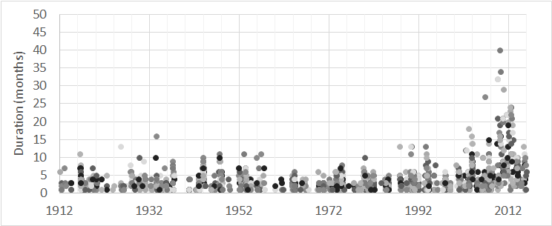
Some results (from last April!) about the temporal evolution of the droughts over mainland Portugal from October 1910 until September 2018 (108 years)
Duration of the periods under consecutive drought conditions
Very pronounced increase of the duration in recent years
24

Slide 25
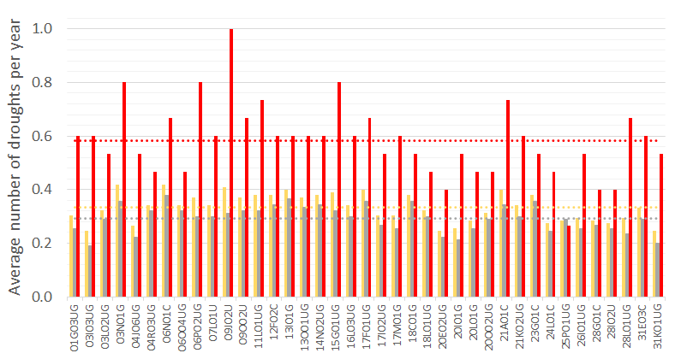
Some results (from last April!) about the temporal evolution of the droughts over mainland Portugal from October 1910 until September 2018 (108 years)
Average number of droughts per year in 39 rain gages even distributed over the country
Yellow bars, in the 108-year period and red bars, in the last 15 years
Almost twice in the last 15 years !!!
25

Slide 26
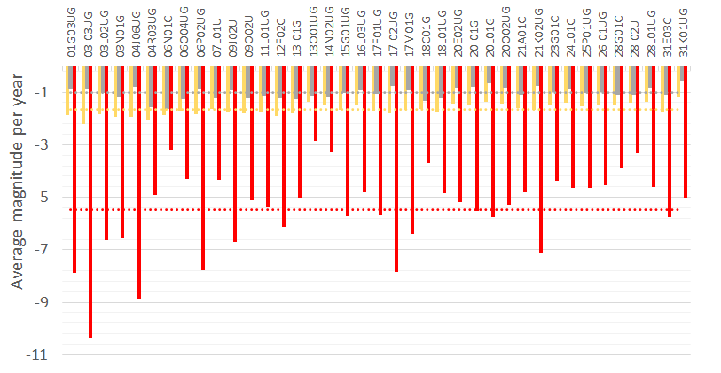
Some results (from last April!) about the temporal evolution of the droughts over mainland Portugal from October 1910 until September 2018 (108 years)
Average magnitude of the droughts per year in 39 rain gages even distributed over the country
Yellow bars – in the 108-year period and bars in the last 15 years (almost twice!!!)
Yellow bars, in the 108-year period (approx. -1.8) and red bars in the last 15 years (approx. -5.5)
Three times worse in the last 15 years!!!
26

Slide 27
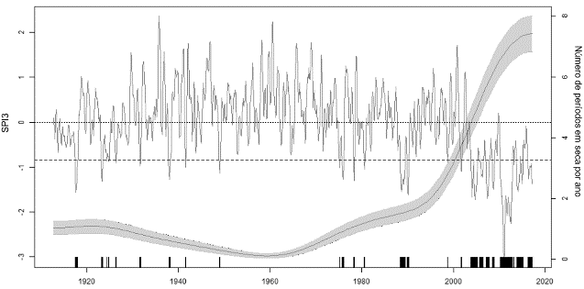
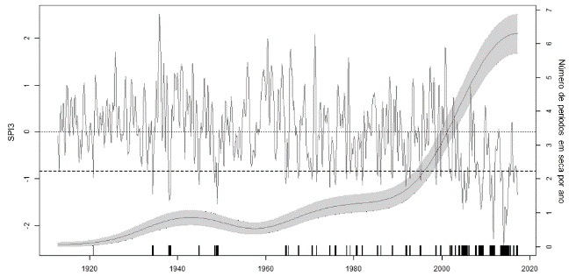
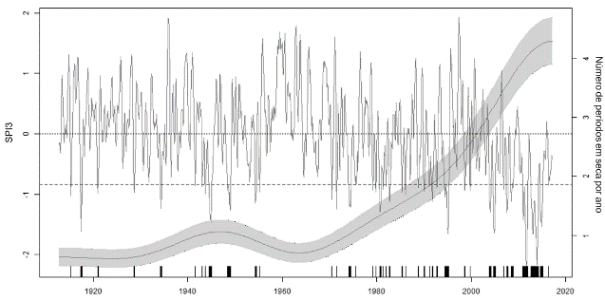
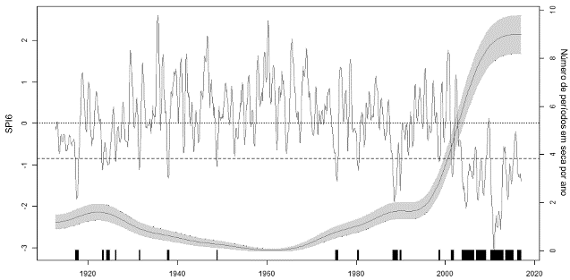
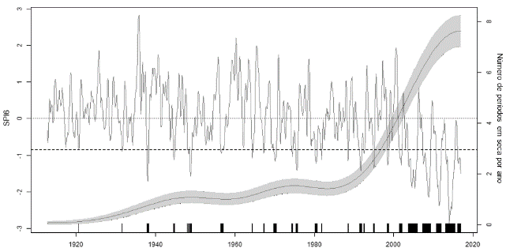
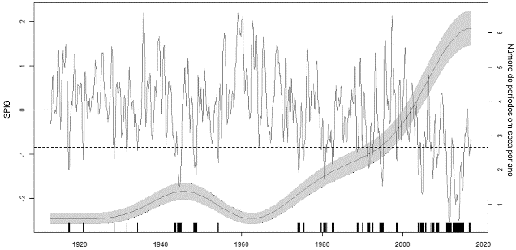
Some results (from last April!) about the temporal evolution of the droughts over mainland Portugal from October 1910 until September 2018 (108 years)
Frequency of the periods under drought conditions in three rain gages (similar behaviour regardless the rain gage)
Leonte rain gage
Carviçais rain gage
Pernes rain gage
SPI3
SPI6
Very pronounced increase in the frequency of the periods under drought conditions in recent years
27

Slide 28
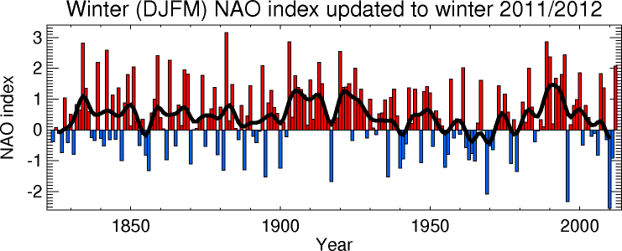
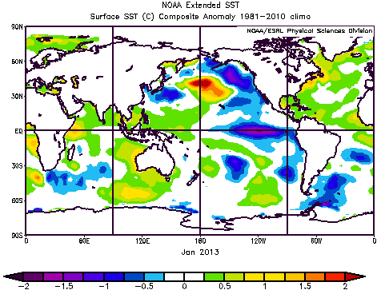
… to develop forecasting capabilities based on teleconnection indexes
For Portugal – probability maps for different time scales and drought intensities – still a long walk

Slide 29
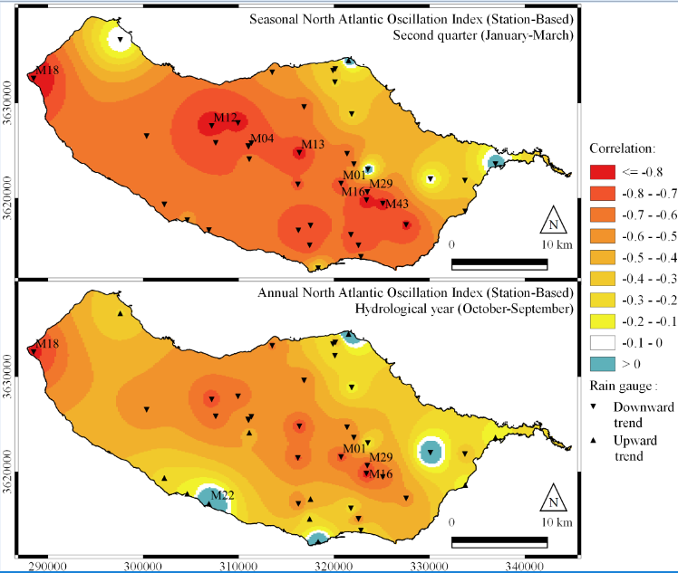
… to develop forecasting capabilities based on teleconnection indexes
Case study of Madeira Island - NAO

Slide 30
… to develop forecasting capabilities based on teleconnection indexes
For Portugal – probability maps for different time scales and drought intensities – still a long walk
IST newest bet - drought forecasting based on copulas

Slide 31
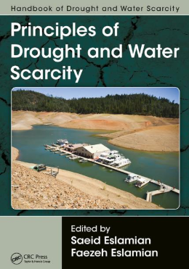
Third Session – Topics for the training material
Challenge from water scarcity and droughts
Fundamental requirements
Background on time series and on general statistical concepts
Advanced topics on statistical models
Computational capabilities (the drought assessment can not be done based exclusively in the Excel)
References are available all around the world
CRC Press
Published July 12, 2017
Reference - 674 Pages - 201 B/W Illustrations
ISBN 9781498731027 - CAT# K26164
31

Slide 32
TABLE OF CONTENTS
1 Definition of Drought
2 Desertification and Drought
3 Meteorological Drought Indices: Definitions
4 Hydrological Drought: Water Surface and Duration Curve Indices
5 Agricultural Drought Indices: Combining Crop, Climate, and Soil Factors
6 Agricultural Drought: Organizational Perspectives
7 Ocean Oscillation and Drought Indices: Principles
8 Ocean Oscillation and Drought Indices: Application
9 Cause and Occurrence of Drought
10 Drought Modeling Methods
11 Drought Modeling Examples
12 Observational Network and Drought Monitoring
32

Slide 33
TABLE OF CONTENTS (Cont.)
13 Real-Time Drought Management
14 Monitoring, Assessment, and Forecasting of Drought Using Remote Sensing and the Geographical Information System
15 Regionalization of Drought Prediction
16 Drought Severity in a Changing Climate
17 Drought Early Warning and Information Systems
18 Drought Assessment and Risk Analysis
19 New Approaches for Effective Drought Risk Assessment
20 Drought and Acceptable Risks for Public Systems
21 Remote Sensing in Drought Quantification and Assessment
22 NASA Satellite–Based Global Precipitation Products and Services for Drought
23 Application of Data-Driven Models in Drought Forecasting
24 Application of Intelligent Technology in Rainfall Analysis
33

Slide 34
TABLE OF CONTENTS (Cont.)
25 Application of the Optimization Models and Decision Support Systems in Drought
26 Copula Functions and Drought
27 Drought Frequency Characterization in Spain by Means of T Analysis
28 Rainfall Prediction Using Time Series Analysis
29 Meteorological Drought Indices: Rainfall Prediction in Argentina
30 Modeling Hydrological Process by ARIMA–GARCH Time Series
31 Gradation of Drought-Prone Area
32 Social Aspects of Water Scarcity and Drought
33 Drought Losses to Local Economy
34 Analysis of Drought Factors Affecting the Economy
It will be relatively simple to identify a logical and suitable sequence of topics suitable for the training (scope and schedule) related with droughts and water scarcity
34

Slide 35
Third Session – Topics for the training material
Challenge from water scarcity and droughts
Workshop on innovative practices in the EU water sector: barriers and opportunities / 8th to 10th May 2019
This project has been funded with support from the European Commission. This publication reflects the views only of the author, and the Commission cannot be held responsible for any use which may be made of the information contained therein.

